Slide 1


http://www.comp.nus.edu.sg/~cs2100/
Lecture #4a
Pointers and Functions

Slide 2
Questions?
Ask at https://app.sli.do/event/bRPtUxgykAQjjF5XBpLedo
OR
Scan and ask your questions here! (May be obscured in some slides)

Slide 3
Lecture #4: Pointers and Functions (1/2)
Pointers
1.1 Pointer Variable
1.2 Declaring a Pointer
1.3 Assigning Value to a Pointer
1.4 Accessing Value Through Pointer
1.5 Example #1
1.6 Example #2
1.7 Tracing Pointers
1.8 Incrementing a Pointer
1.9 Common Mistake
1.10 Why Do We Use Pointers?

Slide 4
Lecture #4: Pointers and Functions (2/2)
Calling Functions
User-Defined Functions
Pass-by-Value and Scope Rule
4.1 Consequence of Pass-by-Value
Functions with Pointer Parameters
5.1 Function to Swap Two Variables
5.2 Examples

Slide 5
1. Pointers (1/3)
While C is a high-level programming language, it is usually considered to be at the lower end of the spectrum due to a few reasons, among which are:
It has pointers which allow direct manipulation of memory contents
It has a set of bit manipulation operators, allowing efficient bitwise operations
In Lecture #2a slide 11, we say that a variable has
a name (identifier);
a data type; and
an address.

Slide 6
1. Pointers (2/3)
Data type
Name
A variable occupies some space in the computer memory, and hence it has an address.
The programmer usually does not need to know the address of the variable (she simply refers to the variable by its name), but the system keeps track of the variable’s address.
int a;
a = 123;
May only contain integer value
a
123
Where is variable a located in the memory?

Slide 7
1. Pointers (3/3)
You may refer to the address of a variable by using the address operator & (ampersand)
Address.c
int a = 123;
printf("a = %d\n", a);
printf("&a = %p\n", &a);
a = 123
&a = ffbff7dc
%p is used as the format specifier for addresses
Addresses are printed out in hexadecimal (base 16) format
The address of a variable varies from run to run, as the system allocates any free memory to the variable

Slide 8
1.1 Pointer Variable
A variable that contains the address of another variable is called a pointer variable, or simply, a pointer.
Example: a pointer variable a_ptr is shown as a blue box below. It contains the address of variable a.
a_ptr
a
Assuming that variable a is located at address ffbff7dc.
ffbff7dc
123
Variable a_ptr is said to be pointing to variable a.
If the address of a is immaterial, we simply draw an arrow from the blue box to the variable it points to.
a_ptr
a
123

Slide 9
1.2 Declaring a Pointer
Syntax:
type *pointer_name;
pointer_name is the name (identifier) of the pointer
type is the data type of the variable this pointer may point to
Example: The following statement declares a pointer variable a_ptr which may point to any int variable
Good practice to name a pointer with suffix _ptr or _p
int *a_ptr;

Slide 10
1.3 Assigning Value to a Pointer
Since a pointer contains an address, only an address may be assigned to a pointer
Example: Assigning address of a to a_ptr
int a = 123;
int *a_ptr; // declaring an int pointer
a_ptr = &a;
a_ptr
a
123
We may initialise a pointer during its declaration:
int a = 123;
int *a_ptr = &a; // initialising a_ptr

Slide 11
Visualization
int a = 123;
int *a_ptr;
a_ptr = &a;
address
name
value
…
…
…
ffbff7dc
a
123
…
…
…
ffbff7ff
…
ffbff7dc
a_ptr
1234567890
…
…
…

Slide 12
1.4 Accessing Variable Through Pointer
a_ptr
a
123
Once we make a_ptr points to a (as shown above), we can now access a directly as usual, or indirectly through a_ptr by using the indirection operator (also called dereferencing operator) *
printf("a = %d\n", *a_ptr);
≡
printf("a = %d\n", a);
*a_ptr = 456;
≡
a = 456;
Hence, *a_ptr is synonymous with a

Slide 13
1.5 Example #1
i
12
j
12
int i = 10, j = 20;
int *p; // p is a pointer to some int variable
10
20
p
p = &i; // p now stores the address of variable i
printf("value of i is %d\n", *p);
Important!
Now *p is equivalent to i
value of i is 10
// *p accesses the value of pointed/referred variable
*p = *p + 2; // increment *p (which is i) by 2
// same effect as: i = i + 2;
p = &j; // p now stores the address of variable j
Important!
Now *p is equivalent to j
*p = i; // value of *p (which is j now) becomes 12
// same effect as: j = i;

Slide 14
1.6 Example #2 (1/2)
a
Pointer.c
#include <stdio.h>
int main(void) {
double a, *b;
b = &a;
*b = 12.34;
printf("%f\n", a);
return 0;
}
b
Can you draw the picture?
What is the output?
12.340000
What is the output if the printf() statement is changed to the following?
printf("%f\n", *b);
12.340000
printf("%f\n", b);
Compile with warning
printf("%f\n", *a);
Error
What is the proper way to print a pointer? (Seldom need to do this.)
Value in hexadecimal; varies from run to run.
printf("%p\n", b);
ffbff6a0

Slide 15

1.6 Example #2 (2/2)
How do we interpret the declaration?
double a, *b;
The above is equivalent to
double a; // this is straight-forward: a is a double variable
double *b;
We can read the second declaration as
*b is a double variable, so this implies that ...
b is a pointer to some double variable
The following are equivalent:
double a;
double *b;
b = &a;
double a;
double *b = &a;
But this is not the same as above (and it is not legal):
double a;
double b = &a;

Slide 16
End of File

Slide 17
http://www.comp.nus.edu.sg/~cs2100/
Lecture #4b
Pointers and Functions

Slide 18
Questions?
Ask at https://app.sli.do/event/bRPtUxgykAQjjF5XBpLedo
OR
Scan and ask your questions here! (May be obscured in some slides)

Slide 19
1.7 Tracing Pointers (1/2)
Trace the code below manually to obtain the outputs.
Compare your outputs with your neighbours.
TracePointers.c
int a = 8, b = 15, c = 23;
int *p1, *p2, *p3;
p1 = &b;
p2 = &c;
p3 = p2;
printf("1: %d %d %d\n", *p1, *p2, *p3);
*p1 *= a;
while (*p2 > 0) {
*p2 -= a;
(*p1)++;
}
printf("2: %d %d %d\n", *p1, *p2, *p3);
printf("3: %d %d %d\n", a, b, c);

Slide 20
p1
p2
p3
1.7 Tracing Pointers (2/2)
a
b
c
8
15
23
120
15
int a = 8, b = 15, c = 23;
int *p1, *p2, *p3;
p1 = &b;
p2 = &c;
p3 = p2;
printf("1: %d %d %d\n", *p1, *p2, *p3);
*p1 *= a;
while (*p2 > 0) {
*p2 -= a;
(*p1)++;
}
printf("2: %d %d %d\n", *p1, *p2, *p3);
printf("3: %d %d %d\n", a, b, c);
121
7
122
-1
123
1: 15 23 23
2: 123 -1 -1
3: 8 123 -1

Slide 21
1.8 Incrementing a Pointer
If p is a pointer variable, what does p = p + 1 (or p++) mean?
Recall Lect#2a slide 16:
int takes up 4 bytes
float takes up 4 bytes
char takes up 1 byte
double takes up 8 bytes
int a; float b; char c; double d;
int *ap; float *bp;
char *cp; double *dp;
ap = &a; bp = &b; cp = &c; dp = &d;
printf("%p %p %p %p\n", ap, bp, cp, dp);
ap++; bp++; cp++; dp++;
printf("%p %p %p %p\n", ap, bp, cp, dp);
ap += 3;
printf("%p\n", ap);
ffbff0a4 ffbff0a0 ffbff09f ffbff090
+4
+4
+1
+8
ffbff0a8 ffbff0a4 ffbff0a0 ffbff098
+12
ffbff0b4
IncrementPointers.c

Slide 22

1.9 Common Mistake
CommonMistake.c
int *n;
*n = 123;
printf("%d\n", *n);
What’s wrong with this?
Can you draw the picture?
?
n
Where is the pointer n pointing to?
Where is the value 123 assigned to?
Result: Segmentation Fault (core dumped)
Remove the file “core” from your directory. It takes up a lot of space!

Slide 23
1.10 Why Do We Use Pointers?
It might appear that having a pointer to point to a variable is redundant since we can access the variable directly
The purpose of pointers is apparent later when we pass the address of a variable into a function, for example, in the following scenarios:
To pass the addresses of two or more variables to a function so that the function can pass back to its caller new values for the variables
To pass the address of the first element of an array to a function so that the function can access all elements in the array

Slide 24
Quiz
Please complete Pointers and Functions Quiz 1 before 3 pm on 23 August 2022.

Slide 25
End of File

Slide 26
http://www.comp.nus.edu.sg/~cs2100/
Lecture #4c
Pointers and Functions

Slide 27
Questions?
Ask at https://app.sli.do/event/bRPtUxgykAQjjF5XBpLedo
OR
Scan and ask your questions here! (May be obscured in some slides)

Slide 28
2. Calling Functions (1/3)
In C, there are many libraries offering functions for you to use.
Eg: scanf() and printf() – requires to include <stdio.h>
C provides many libraries, for example, the math library
To use math functions, you need to
Include <math.h> AND
Compile your program with –lm option (i.e. gcc –lm …) in sunfire
See table (next slide) for some math functions

Slide 29
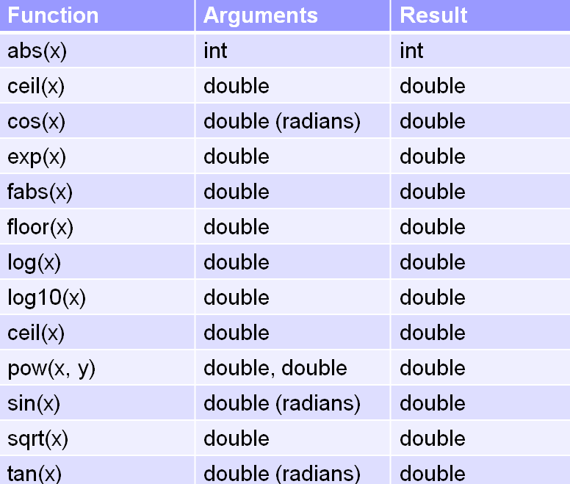
2. Calling Functions (2/3)
Function prototype:
double pow(double x, double y)
function return type

Slide 30
2. Calling Functions (3/3)
To link to Math library
MathFunctions.c
$ gcc –lm MathFunctions.c
$ a.out
Enter x and y:
#include <stdio.h>
#include <math.h>
int main(void) {
int x, y;
float val;
printf("Enter x and y: ");
scanf("%d %d", &x, &y);
printf("pow(%d, %d) = %f\n", x, y, pow(x,y));
printf("Enter value: ");
scanf("%f", &val);
printf("sqrt(%f) = %f\n", val, sqrt(val));
return 0;
}
3 4
pow(3,4) = 81.000000
Enter value:
65.4
sqrt(65.400002) = 8.087027

Slide 31
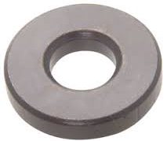
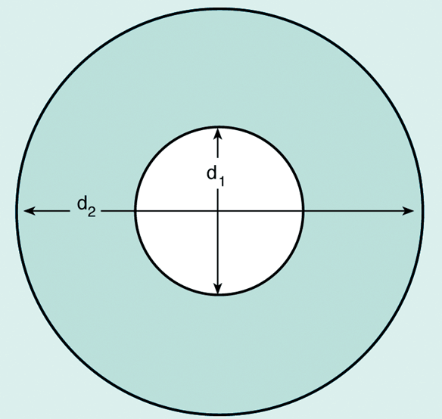
3. User-Defined Functions (1/6)
We can define and use our own functions
Example: Compute the volume of a flat washer. Dimensions of a flat washer are usually given as an inner diameter, an outer diameter, and a thickness.
rim area = π(d₂/2)² – π(d₁/2)²

Slide 32
3. User-Defined Functions (2/6)
Washer.c
#include <stdio.h>
#include <math.h>
#define PI 3.14159
int main(void) {
double d1, // inner diameter
d2, // outer diameter
thickness, outer_area, inner_area, rim_area, volume;
// read input data
printf("Enter inner diameter, outer diameter, thickness: ");
scanf("%lf %lf %lf", &d1, &d2, &thickness);
// compute volume of a washer
outer_area = PI * pow(d2/2, 2);
inner_area = PI * pow(d1/2, 2);
rim_area = outer_area - inner_area;
volume = rim_area * thickness;
printf("Volume of washer = %.2f\n", volume);
return 0;
}
Enter …: 8.2 10.5 2.2
Volume of washer = 74.32

Slide 33
3. User-Defined Functions (3/6)
Note that area of circle is computed twice. For code reusability, it is better to define a function to compute area of a circle.
double circle_area(double diameter) {
return PI * pow(diameter/2, 2);
}
We can then call/invoke this function whenever we need it.
circle_area(d2) → to compute area of circle with diameter d2
circle_area(d1) → to compute area of circle with diameter d1

Slide 34
3. User-Defined Functions (4/6)
WasherV2.c
#include <stdio.h>
#include <math.h>
#define PI 3.14159
double circle_area(double);
int main(void) {
// code similar to Washer.c; omitted here
// compute volume of a washer
rim_area = circle_area(d2) – circle_area(d1);
volume = rim_area * thickness;
printf("Volume of washer = %.2f\n", volume);
return 0;
}
// This function returns the area of a circle
double circle_area(double diameter) {
return PI * pow(diameter/2, 2);
}
Function prototype
Function definition

Slide 35
3. User-Defined Functions (5/6)
It is a good practice to put function prototypes at the top of the program, before the main() function, to inform the compiler of the functions that your program may use and their return types and parameter types.
A function prototype includes only the function’s return type, the function’s name, and the data types of the parameters (names of parameters are optional).
Function definitions to follow after the main() function.
Without function prototypes, you will get error/warning messages from the compiler.

Slide 36
3. User-Defined Functions (6/6)
Let’s remove (or comment off) the function prototype for circle_area() in WashersV2.c
Messages from compiler:
WashersV2.c: In function ‘main’:
WashersV2.c:19:2: warning: implicit declaration of function ‘circle_area’ [-Wimplicit-function-declaration]
rim_area = circle_area(d2) – circle_area(d1);
^
WasherV2.c: At top level:
WashersV2.c:27:8: error: conflicting types for ‘circle-area’
:
Without function prototype, compiler assumes the default (implicit) return type of int for circle_area() when the function is used in line 19, which conflicts with the function header of circle_area() when the compiler encounters the function definition later in line 27.

Slide 37
End of File

Slide 38
http://www.comp.nus.edu.sg/~cs2100/
Lecture #4d
Pointers and Functions

Slide 39
Questions?
Ask at https://app.sli.do/event/bRPtUxgykAQjjF5XBpLedo
OR
Scan and ask your questions here! (May be obscured in some slides)

Slide 40
4. Pass-by-Value and Scope Rule (1/4)
In C, the actual parameters are passed to the formal parameters by a mechanism known as pass-by-value.
a
b
int main(void) {
double a = 10.5, b = 7.8;
printf("%.2f\n", sqrt_sum_square(3.2, 12/5);
printf("%.2f\n", sqrt_sum_square(a, a+b);
return 0;
}
10.5
7.8
Actual parameters:
10.5 and 18.3
3.2 and 2.0
double sqrt_sum_square(double x, double y) {
double sum_square;
sum_square = pow(x,2) + pow(y,2);
return sqrt(sum_square);
}
Formal parameters:
x
y
10.5
18.3
3.2
2.0

Slide 41
4. Pass-by-Value and Scope Rule (2/4)
Formal parameters are local to the function they are declared in.
Variables declared within the function are also local to the function.
Local parameters and variables are only accessible in the function they are declared – scope rule.
When a function is called, an activation record is created in the call stack, and memory is allocated for the local parameters and variables of the function.
Once the function is done, the activation record is removed, and memory allocated for the local parameters and variables is released.
Hence, local parameters and variables of a function exist in memory only during the execution of the function. They are called automatic variables.
In contrast, static variables exist in the memory even after the function is executed.

Slide 42
4. Pass-by-Value and Scope Rule (3/4)
What’s wrong with this code?
int f(int);
int main(void) {
int a;
...
}
int f(int x) {
return a + x;
}
Answer:
Variable a is local to main(), not f(). Hence, variable a cannot be used in f().
❖

Slide 43
4. Pass-by-Value and Scope Rule (4/4)
Trace this code by hand and write out its output.
A void function is a function that does not return any value.
In main, before: a=2, b=3
In g, before: a=2, b=3
#include <stdio.h>
void g(int, int);
int main(void) {
int a = 2, b = 3;
printf("In main, before: a=%d, b=%d\n", a, b);
g(a, b);
printf("In main, after : a=%d, b=%d\n", a, b); return 0;
}
void g(int a, int b) {
printf("In g, before: a=%d, b=%d\n", a, b);
a = 100 + a;
b = 200 + b;
printf("In g, after : a=%d, b=%d\n", a, b);
}
In g, after : a=102, b=203
In main, after : a=2, b=3
main
addr
name
val
_
a
2
_
b
3
g
addr
name
val
_
a
2
102
_
b
3
203
PassByValue.c
❖

Slide 44
4.1 Consequence of Pass-by-Value
Can this code be used to swap the values in a and b?
In main, before: a=2, b=3
#include <stdio.h>
void swap(int, int);
int main(void) {
int a = 2, b = 3;
printf("In main, before: a=%d, b=%d\n", a, b);
swap(a, b);
printf("In main, after : a=%d, b=%d\n", a, b); return 0;
}
void swap(int a, int b) {
int temp = a;
a = b;
b = temp;
}
In main, after : a=2, b=3
No
SwapIncorrect.c
❖

Slide 45
5. Function with Pointer Parameters (1/3)
A function may not return any value (called a void function), or it may return a value.
All parameters and variables in a function are local to the function (scope rule).
Arguments from a caller are passed by value to a function’s parameters.
How do we then allow a function to return more than one value, or modify values of variables defined outside it?
An example is swapping two variables. How can we write a function to do that? The previous slide shows a negative example.

Slide 46
5. Function with Pointer Parameters (2/3)
What happens in SwapIncorrect.c?
It’s all about pass-by-value and scope rule!
In main():
a
b
2
3
a
b
In swap():
2
3
3
2
No way for swap() to modify the values of variables that are outside its scope (i.e. a and b), unless...

Slide 47
5. Function with Pointer Parameters (3/3)
The only way for a function to modify the value of a variable outside its scope, is to find a way for the function to access that variable
Solution: Use pointers!
In main():
a
b
2
3
ptr1
ptr2
In swap():

Slide 48
5.1 Function To Swap Two Variables
3
2
#include <stdio.h>
void swap(int *, int *);
int main(void) {
int a, b;
printf("Enter two integers: ");
scanf("%d %d", &var1, &var2);
swap( &a, &b );
printf("var1 = %d; var2 = %d\n", var1, var2);
return 0;
}
void swap(int *ptr1, int *ptr2) {
int temp;
temp = *ptr1; *ptr1 = *ptr2; *ptr2 = temp;
}
In main():
a
2
b
3
In swap():
ptr1
ptr2
SwapCorrect.c

Slide 49
5.2 Examples (1/4)
Example1.c
#include <stdio.h>
void f(int, int, int);
int main(void) {
int a = 9, b = -2, c = 5;
f(a, b, c);
printf("a = %d, b = %d, c = %d\n", a, b, c);
return 0;
}
void f(int x, int y, int z) {
x = 3 + y;
y = 10 * x;
z = x + y + z;
printf("x = %d, y = %d, z = %d\n", x, y, z);
}
a
b
c
9
-2
5
x
y
z
9
-2
5
1
10
16
x = 1, y = 10, z = 16
a = 9, b = -2, c = 5

Slide 50
5.2 Examples (2/4)
Example2.c
#include <stdio.h>
void f(int *, int *, int *);
int main(void) {
int a = 9, b = -2, c = 5;
f(&a, &b, &c);
printf("a = %d, b = %d, c = %d\n", a, b, c);
return 0;
}
void f(int *x, int *y, int *z)
{
*x = 3 + *y;
*y = 10 * *x;
*z = *x + *y + *z;
printf("*x = %d, *y = %d, *z = %d\n", *x, *y, *z);
}
1
10
16
a
b
c
9
-2
5
x
y
z
*x is a, *y is b, and *z is c!
*x = 1, *y = 10, *z = 16
a = 1, b = 10, c = 16

Slide 51
5.2 Examples (3/4)
Example3.c
#include <stdio.h>
void f(int *, int *, int *);
int main(void) {
int a = 9, b = -2, c = 5;
f(&a, &b, &c);
printf("a = %d, b = %d, c = %d\n", a, b, c);
return 0;
}
void f(int *x, int *y, int *z)
{
*x = 3 + *y;
*y = 10 * *x;
*z = *x + *y + *z;
printf("x = %d, y = %d, z = %d\n", x, y, z);
}
Compiler warnings, because x, y, z are NOT integer variables!
They are addresses (or pointers).

Slide 52
5.2 Examples (4/4)
Example4.c
#include <stdio.h>
void f(int *, int *, int *);
int main(void) {
int a = 9, b = -2, c = 5;
f(&a, &b, &c);
printf("a = %d, b = %d, c = %d\n", a, b, c);
return 0;
}
void f(int *x, int *y, int *z)
{
*x = 3 + *y;
*y = 10 * *x;
*z = *x + *y + *z;
printf("x = %p, y = %p, z = %p\n", x, y, z);
}
Addresses of variables a, b and c. (Values change from run to run.)
Use %p for pointers.
x = ffbff78c, y = ffbff788, z = ffbff784
a = 1, b = 10, c = 16

Slide 53
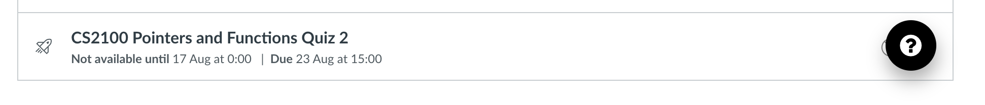
Quiz
Please complete Pointers and Functions Quiz 2 before 3 pm on 23 August 2022.

Slide 54
End of File

